Slide 1
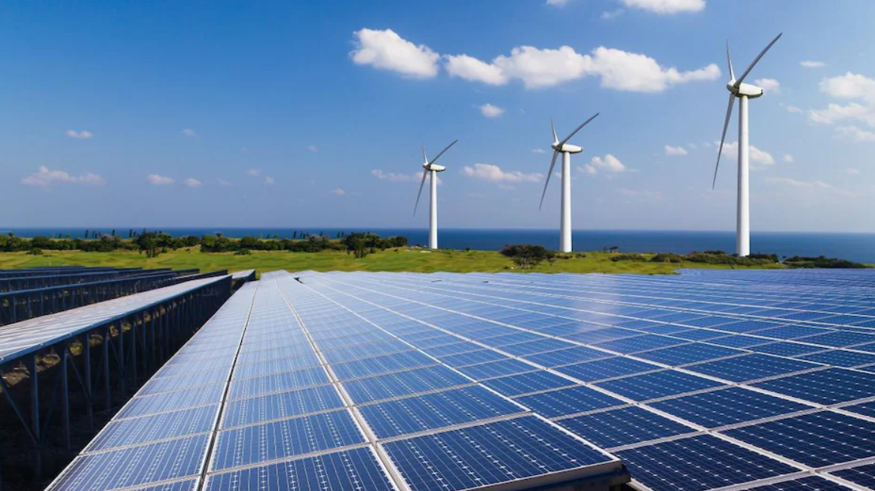
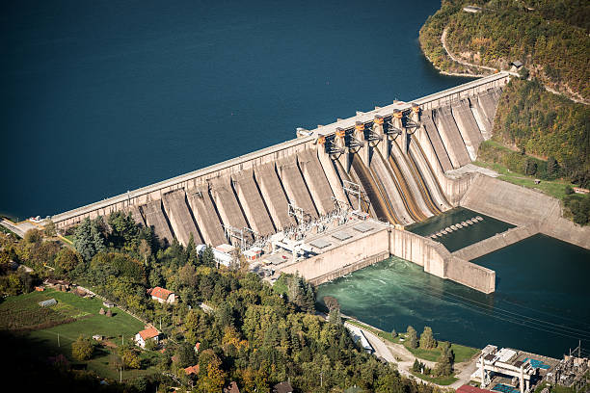
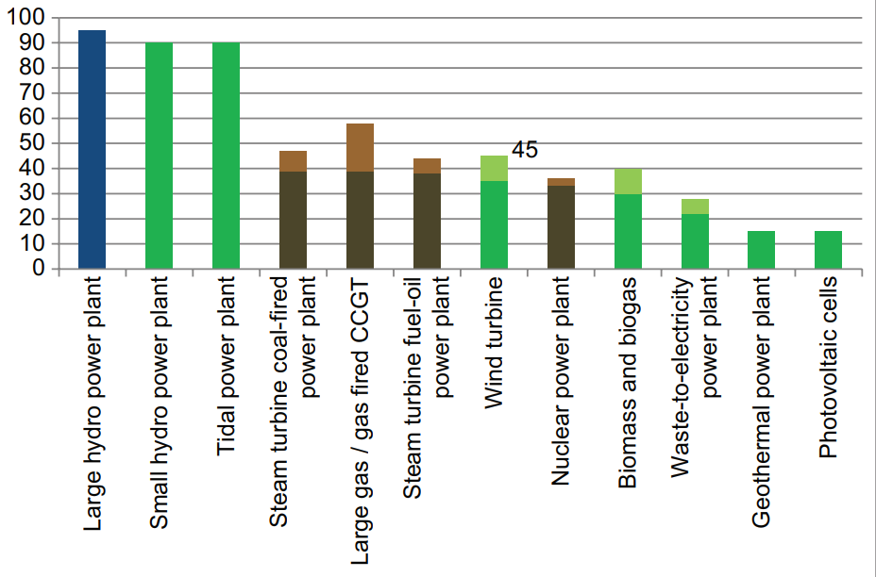
Advantages and Disadvantages of Green Technology
Audit Course-III Subject : Environmental Studies
Introduction
Renewable energy sources are still not the predominant energy resource in the energy sector, although in certain developed countries they participate
in a significant share in electricity generation. It is estimated that world energy consumption from renewable energy sources exceeds 20% at the present and continues to grow. Renewable energy sources appear
as an additional source of energy in the conventional electro-industry. The main reason for the increasing investment and exploitation of renewables is certainly environment preservation and environmental aspect of sustainability. This study seeks to expand the existing literature and contribute to a comprehensive understanding of the characteristics of renewable
energy sources as a whole. Therefore, the purpose of
this paper is to determine the advantages and disadvantages of renewable energy sources utilization in general, without considering the individual type of renewables, such as wind or solar energy. Thereby, the paper presents numerous advantages of using renewable energy in the electricity generation, such as environment preservation in terms of reduced greenhouse gas emissions or improvement of innovations and technical/technological development. There are also presented certain disadvantages of renewables in the production of electricity, such as dependence on weather conditions or low energy efficiency and low ability to produce electricity.
Method/Approach/Proposed Idea
Nowadays industries consume more energy than what it is essential, so it leads to more pollution. That’s why it is necessary to create a managerial system based on green processes and products to decrease the pollutions. Besides, the opportunities are provided in green technology. Governments, companies and industries all around the globe seek have been seeking for methods and techniques to diminish the waste, because the earth’s environment is not in a proper situation today in terms of pollution for instance: water contamination, global warming and forest disappearing which are main difficulties for environment.
Green processes and technology refers to making efforts to improve energy efficiency or reduce the pollution produced by your home, business and general living habits. The main purpose of this kind of processes and technology is to reduce the potential negative impact that energy consumption and pollution can have on the environment. While environmentally friendly living is a positive ideal, there are several possible disadvantages of Green processes and technology such as: high implementing costs, lack of information, no known alternative chemical or raw material inputs, no known alternative process technology, uncertainty about performance impacts, and lack of human resources and skills.
Advantages
The advantage of using green energy sources is that it must be clean therefore there is no discharge or damage into the environment or atmosphere. Generating energy that produces no greenhouse gas emissions from fossil fuels and reduces some types of air pollution.
Diversifying energy supply and reducing dependence on imported fuels. Creating economic development and jobs in manufacturing, installation, and more. If wind generators demand more room or space, they could be set up in the proximity of the coastline instead of positioning these on land. A study reveals you could get more electric power while these happen to be in the sea. As the weather is something we are not able to regulate, it is far from every day that there's a weather disruption so this too shall pass.
- Environmental protection (reduced greenhouse
gas emissions)
- Reduced fossil fuel consumption
- Reduced energy imports dependence
- Stimulating the development of innovation and
the economy
- Increasing employment
- Rural development
- Reduction of energy scarcity (expansion of
rural electrification capacities)
Disadvantages
In addition to the multiple advantages of using renewable energy sources, there are certain disadvantages and limitations in their daily use. It is primarily due to their natural features that renewable sources depend entirely on geographical location and weather conditions, namely the volatility and unpredictability of the renewable source is a significant limitation and difficulty in electricity generation.
When comparing renewable energy sources with traditional fossil energy resources; renewable sources have a lack of capacity to produce electricity, they are not able to produce as large amounts of electricity as power plants with fossil fuels. In order to try to reduce this shortcoming, it is necessary to further invest in the development of renewable energy technologies, but also simply to build more renewable energy plants
A significant disadvantage of even greater use of renewable energy sources is certainly their relatively high cost of electricity production. The literature suggests a higher cost of building a renewable energy plant compared to fossil power plants. This is especially true for power plants that use marine energy, whose technology is extremely expensive, and due to the specificity of the location, this energy source participates in a negligible share in electricity production. The construction of photovoltaic systems is also a high cost, also due to the high cost of technology and the complexity of making solar panels.
- Weather conditions dependence
- Non-continuity and unpredictability
- Acceptance of renewable electricity in the power system
- Low energy efficiency
- Low maximum capacity utilization/low capacity factor
- Relatively high cost of electricity production
Benefit to the Society
The aims of green technology are myriads. The major objective of green technology is to meet the needs of society in ways without damaging or depleting natural resources on the planet. In addition, the opinion is to meet the present needs without making any compromise. Besides, it is required to find the right destination to get all about the goals of this kind of technology. The concentration of green technology is to make products which can be fully reclaimed or reused. In addition, steps are being taken to decrease wastes and pollution as one of the most indispensable aims of green technology via changing patterns of production and consumption. Ability to meet more stringent environmental regulations in the future: companies which invest in green technology are more likely to be better equipped and ready for rigid environmental regulations as well as commodity specifications which are expected to be imposed on them in the future. Environmental image: adoption of green technology can enhance a company’s environmental reputation which is essential if other rivals and consumers are becoming more environmentally conscious.
Conclusion and Future Work
Consumers request for green technology productions is on sharp increase. Besides, government consumers are highly mandated to purchase green where is available, and the spectrum of the products by such provisions is on the rise. As for business customers, if it is illustrate a return on investment in green products, then request will materialize. The greatest opportunities are in commodities which decrease energy consumption. Even so, a growing number of business purchasers can be expected to be motivated by nothing more than the desire to be perceived as supporting environmental sustainability. Thus, change is coming. The green in technology products is being installed in the R&D phase.
Objectives
Alternative or renewable forms of energy appear as a supplement to conventional forms of energy, and, although in certain developed countries they participate in a significant share in energy production, they are still not the predominant energy resource in the energy sector. It should be noted that, in addition to the production of electricity, alternative forms of energy provide a significant role in the production of thermal energy. Renewable sources in electricity / heat generation do not pollute the environment with greenhouse gas emissions and enable the use of limited fossil resources in the future. This is the main reason for the increasing investment and exploitation of renewable energy sources.
Nowadays there are huge concerns regarding environmental pollution which bring attentions on the utilization of green products and processes. There are a great amount of researchers who have been conducted and are being conducted in different industries with various scopes in this term. However, the essential point is whether green technology are able to adapt in various industries. Certainly, one of the major problems in the globe is pollution which has created a huge concern in relation to the future human life. Therefore, this paper concentrates on the advantages and disadvantages of green technology.
Group Member Details:
Name of Group Member1 : Abhinav Zilkarwar
Class-Div: SE - A
Roll No: 28
Name of Group Member2 : Pratik Pawar
Class-Div: SE - A
Roll No: 27
Department of Computer Engineering,
D.Y. Patil College, of Engineering,
Akurdi, Pune-44.
Efficiency of different technologies in electricity generation (%)

